Slide 1
An analysis of user engagement in an online mental health support group Jay Barnes

Slide 2
Reasons for staying for the last presentation
I’m really interested in the topic.
I’m too embarrassed/shy to leave.
My boss is here, so I have to be.
I might win a prize.
I couldn’t get an earlier flight.
Jay asked me to be part of his discussion group.

Slide 3
Context of research
أنا مجنون
Eu sou maluco
Face-to-face support group (x2) leader for 16 years.
Email / telephone supporter 12+ years.
Online support group leader for 5+years
Spokesman for bipolars (radio, TV, press).
Deputy chairman of Lentegeur Psychiatric Hospital Facilities Board.
ich bin verrückt
Me kon y ño
είμαι τρελλός
Ngi mahlanya
Olen hullu
Ke ya tsenwa
I am crazy
Mimi ni mambo
Je suis fou
estoy loco
sono pazzesco
Jeg er vanvittig
Ek is mal
είμαι τρελλός
Ndinorwara pfungwa
Olen hullu
Notes:
Context – diagnosed bipolar 24 years ago – running support groups for 10+ years – running national website and online support group

Slide 5
Site characteristics
Built on the “Ning” platform
Running since April 2008
Almost 2000 subscribed members (June 2013)
Almost 2000 blogs
More than 1200 discussions (with multiple replies)
Un-moderated / self-moderated

Slide 6
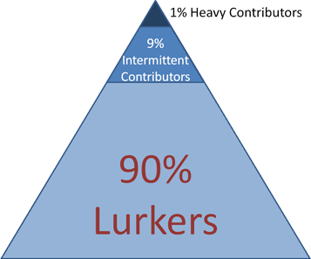
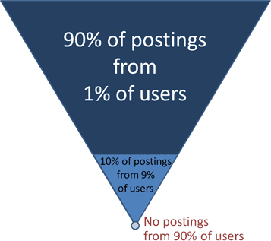
Nielson’s 1-9-90 “law”
Jakob Nielsen’s Alertbox: October 9, 2006
Participation Inequality: Encouraging More Users to Contribute

Slide 7
Website member demographics
Non-response bias?

Slide 8
Visit statistics

Slide 9
Content viewed

Slide 10
Current blog threads
Psychosocial Disability in the Workplace
Weight gain on these 6 Psychiatric Medications
Ooopsie.... (life)
Close call (episode)
How Much Are We Worth? (self-worth)
Current discussion threads
Olexar (medication)
Electric Shock Therapy
Bipolar and pregnancy (technical)
newly diagnosed (information)
Alone, Scared and Helpless

Slide 11
User contribution to content

Slide 12
Methods of information seeking

Slide 13
Content sharing preferences

Slide 14
Members' rating of bipolarsa

