Slide 1
Using smartphones and tablets for medical information access and documenting interactions with patients by Clinical Associates in South Africa
Sailas Nyareza
American International Health Alliance
Pretoria, South Africa
HIV/AIDS Twinning Center www.TwinningAgainstAIDS.org

Slide 2
How We See the World

Slide 3
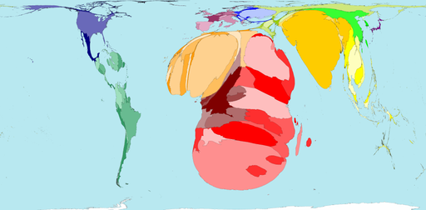
HIV Prevalence
Territory size shows the proportion of all people aged 15-49 with HIV (Human Immunodeficiency Virus) worldwide, living there.

Slide 4
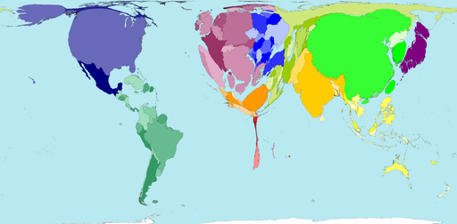
Human Resources for Health
Territory size shows the proportion of all physicians (doctors) that work in that territory.

Slide 5
The American International Health Alliance HIV/AIDS Twinning Center
Health systems strengthening through volunteer-driven twinning partnerships
Notes:
Twinning Center was launched in 2004 by AIHA and HRSA to support PEPFAR programs. We utilise a volunteer-driven, peer-to-peer twinning methodology refined by AIHA over nearly 2 decades of practical implementation in more than 150 partnerships in 33 countries

Slide 6
Clinical Associates A New Kind of Health Professional in South Africa
Mid-level health worker
Physician Assistant/Clinical Officer
Trained to work in South Africa’s rural and district hospitals
Bulk of training in clinical settings and rooted in problem-based learning
3 year Bachelor of Clinical Medical Practice (BCMP)
Qualify to register with the Health Professions Council of South Africa after earning the BCMP
www.clinicalassociate.co.za
Notes:
Mid-level health professionals, the equivalent of the US Physician Assistant
Trained and work in rural hospitals of South Africa
3 year, Bachelor of Clinical Medical Practice
No access to medical information resources in rural hospitals

Slide 7
Clinical Associates Twinning Support

Slide 8
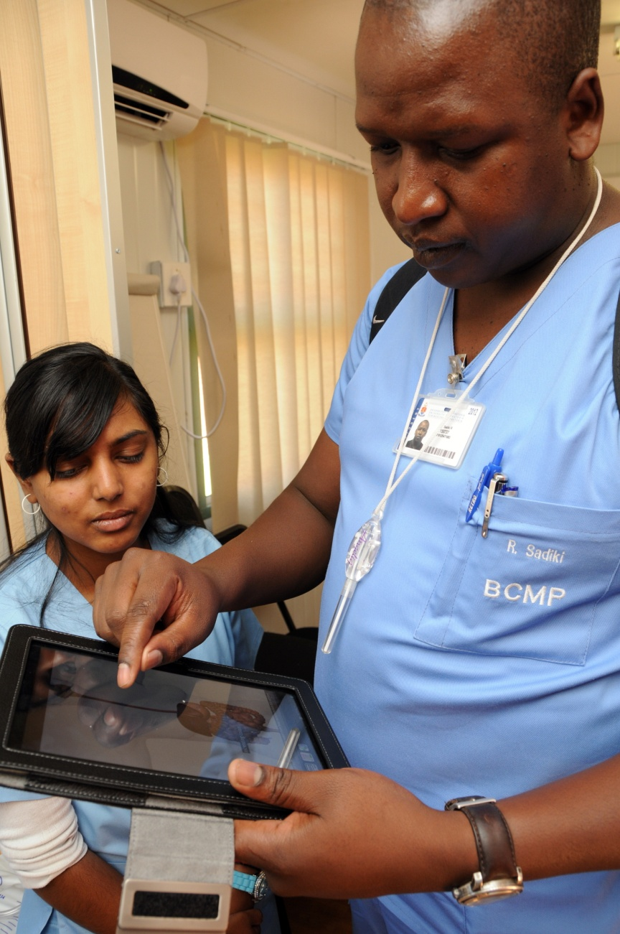
Tembisa Clinical Learning Center

Slide 9
University of Pretoria’s Tembisa Clinical Learning Center
Clinical Associate students are based in rural and
district hospitals with no access to medical
information resources. A pilot study was
conducted to assess the use of tablets devices to
enhance information access and training:
Android based tablets 10.1 (32GB) – collaboration with manufacturers
Medical apps installed (i.e. Medscape, Skyscape, Epocrates, Evernote, Calculate by QxMD etc) allowing offline access to clinical reference resources
Videos of clinical procedures
South African clinical practice guidelines
Manuals, toolkits and e-books
Tablets delivered to 15 second and 3rd year ClinA students at Tembisa Hospital

Slide 10
Tembisa Hospital pilot study
Preliminary findings
Medscape top app
Evernote – an excellent organisation app for PDFs, docs etc
Standard Dictations App
Lack of SA content
Enhanced group discussions
Patient study assign., MiniCEX
Internet Access
Device/Screen size
Discussions
tablet 7 inch?
Coat pocket size?
Local content? 3G, Wi-fi
Platform to connect to other students
Information Literacy program for students

Slide 11
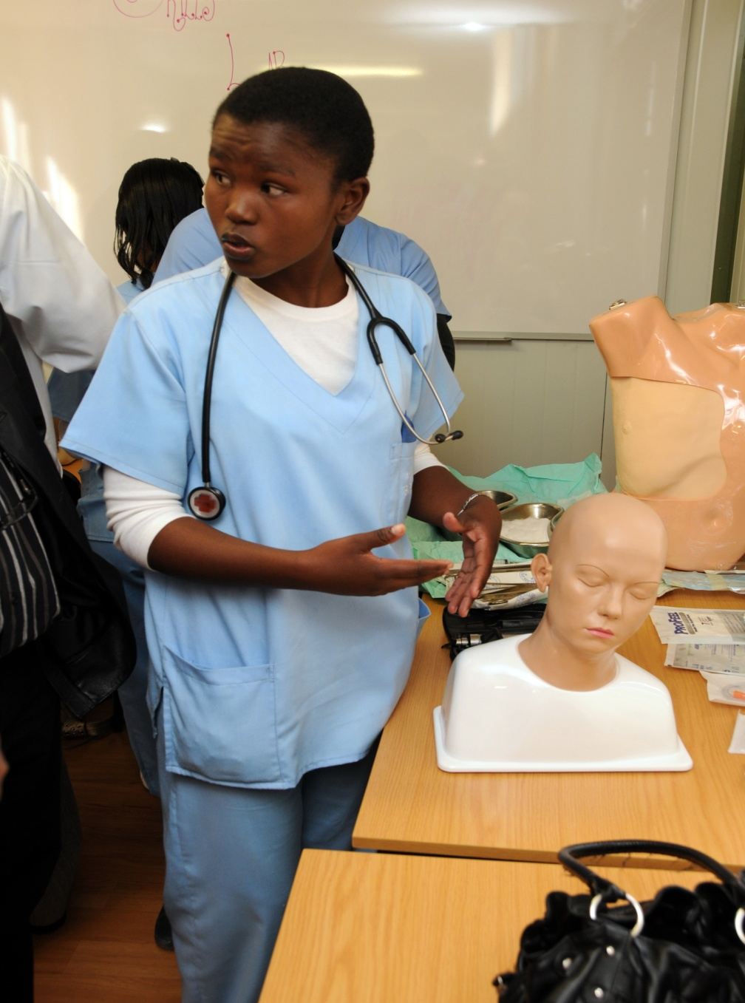
WITS Digital Integration of Clinical Associate Studies (DICAS)
Record completed skills and hours in digital log-books
Digital completion of student evaluations (observed consultations, Mini-CEXs etc)
Devices
Any android based device. Cost of device to be included in the tuition fees
Logbooks
Use an open source software (CommCare App) to register skills and hours entries
Textbooks and study materials
Textbooks, videos of clinical procedures, clinical practice guidelines etc
Medical Apps
Top medical apps from the Google Play store

Slide 12
Thank you!!
Sailas Nyareza
American International Health Alliance
Regional Office for Africa – Pretoria, South Africa

